Slide 1
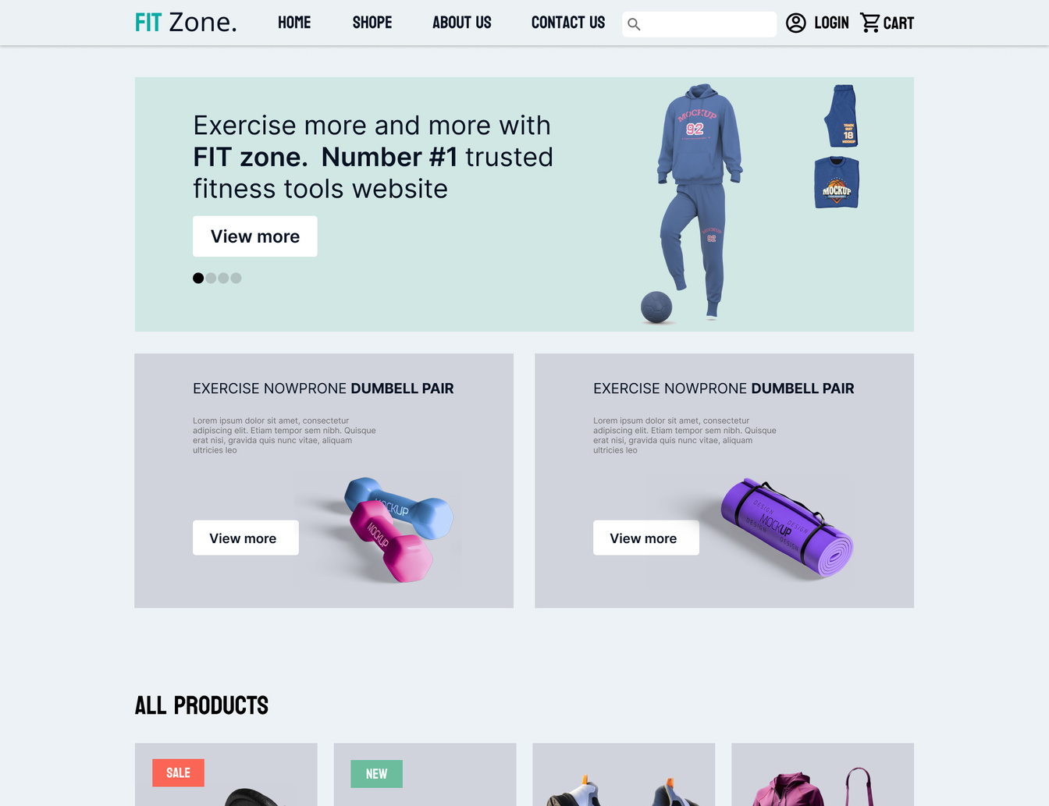
www.fitzone.com
PROJECT
PLAN
Presentation For Yourwebsite
Fit zone is a your only chose to have a healthy life

Slide 2
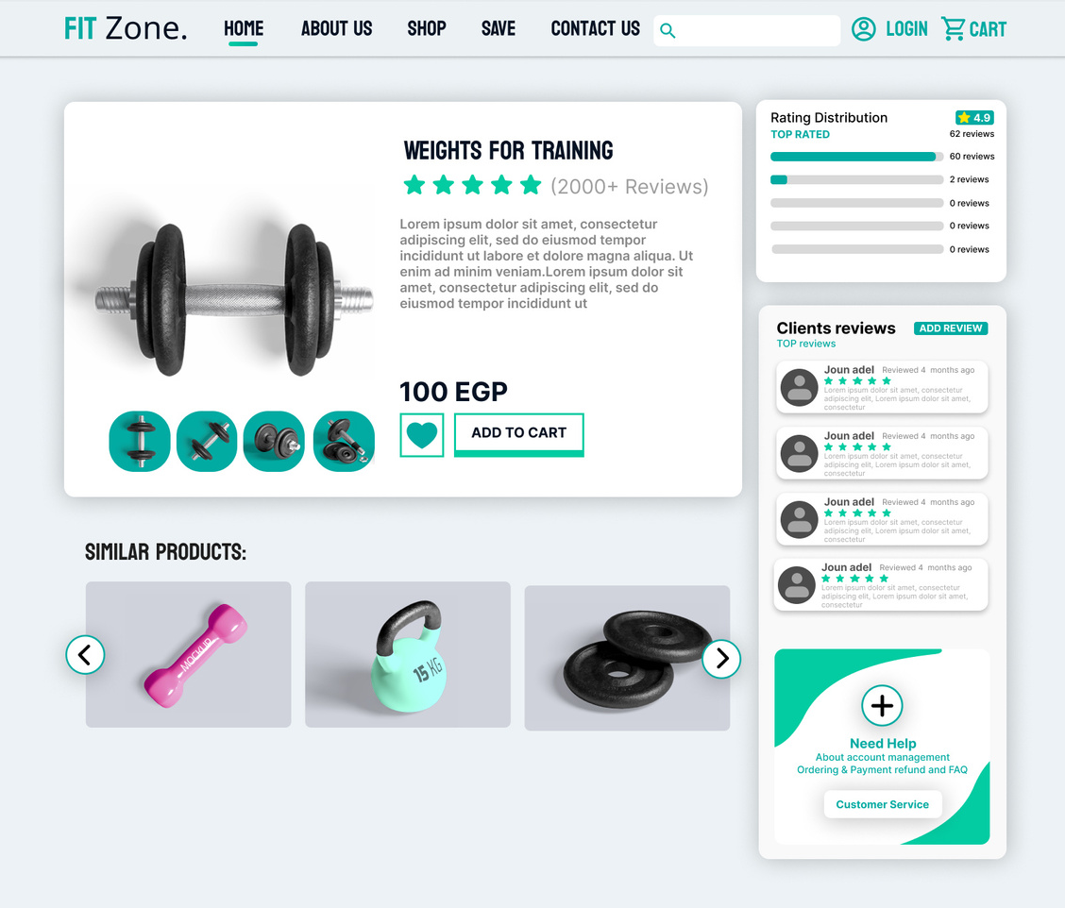
www.Fitzone.com
WEBSITE
DESIGN
responsibility by Ghonemy
ui/ux
logo design
colors
fonts
presentation design

Slide 3

www.fitzone.com
FRONT END

Slide 4
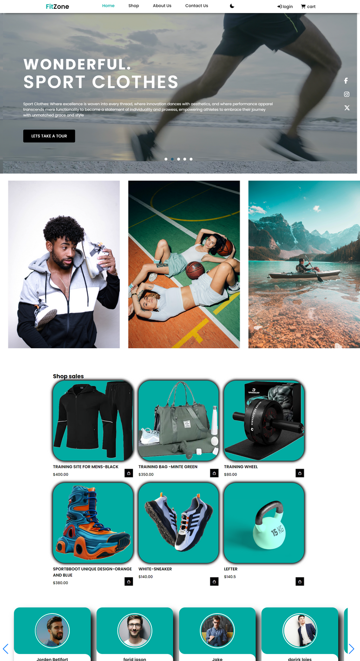
MOHAMMED& AYA
ABDELRHEM
MARIAM
LAILA

Slide 5

www.reallygreatsite.com
MARIAM
responsibility for:
video slider

Slide 6

www.fitzone.com
LAILA
responsibility for :
Footer
Shoop page
card

Slide 7

www.fitzone.com
AYA &
MOHAMMED
responsibility for:
Datils page

Slide 8

www.fitzone.com
ABDELRHEM
responsibility for:
login & signup page
integrate the project

Slide 9

www.fitzone.com
BACK END

Slide 10

www.fitzone.com
SHAHD
responsibility for:
Team leader
Database login & signup page
About us & contact us page

Slide 11

www.fitzone.com
THANK YOU
Presentation For our website

